Slide 1
Reporting Qualitative Data Analysis Results Well
The Qualitative Report Best Practices Series
Ronald J. Chenail, Editor-in-Chief

Slide 2
The Qualitative Report (TQR) Best Practices Series
We designed these presentations to help our editors and reviewers learn the TQR approach to helping authors improve their articles and to learn and utilize best practices in reporting their research studies. We also hope authors consult these resources as they prepare their papers for submission.
As a learning community, we feel our mission is not only to help authors learn how to write better, reviewers how to review better, and editors how to edit better, but also to help our readers to appreciate the aesthetic qualities of a paper well-written.
Please feel free to use these resources in your teaching and learning!

Slide 3
The Qualitative Report Editorial Board Commitment to Quality
Help authors improve their qualitative research reporting
Utilize “best practices” in contemporary qualitative research practice and presentation
Publish articles reflecting the best quality in qualitative research
Maintain supportive and respectful relations

Slide 4
TQR 5 C’s for Quality
Creativity
Control
Clarity
Consistency
Coherence

Slide 5
Reporting Qualitative Data Analysis Results Well

Slide 6
Three Qualitative Data Analysis Reporting Components
The Quality
The Data
The Analysis

Slide 7
The Quality
For component one, the quality, please define what you mean by the finding. Without this definition, we don’t know what you mean by your finding’s qualities.

Slide 8
The Data
For component two, the data, please introduce the excerpt you suggest evidences the finding’s quality. Without the data, we have no evidence upon which to judge your representations of the data’s qualities. It is also important we know the source of the data.

Slide 9
The Analysis
For component three, the analysis, please explain how the data represent the qualities of which you claim the data signify because your analytical comments should bring the relationship between the quality asserted and the excerpt presented transparent and coherent - making your qualitative claims clearly evidenced by the data. Without your testimony, the exhibit must speak for itself, which is not good practice in qualitative data analysis.

Slide 10
The Prescription
So, for each section, please first define the qualitative distinction being presented and then after each excerpt, please explain how you see the talk evidencing the qualities you claim it represents.
As you follow this three-step process, you might find you only need to use one example to evidence your qualitative assertions. Each example provided should be an exhibit for one or more quality analyzed, but listing a series of excerpts exhibiting the same quality does not contribute to the findings; the practice just makes the paper longer. If, however, there are many different qualities to be evidenced, then you should present one example per quality being asserted along with the data-supported analysis articulating each qualitative assertion.

Slide 11
Application Exercise

Slide 12
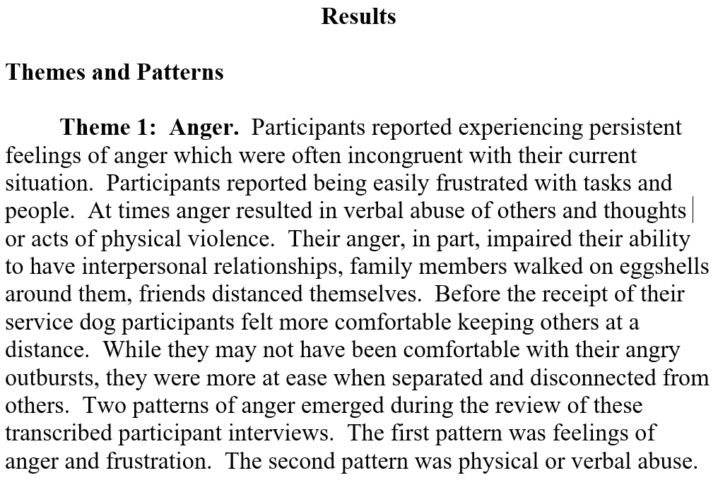
Excerpt One

Slide 13
Excerpt Two

Slide 14
Excerpt Three
Theme 1: Anger | Verbatim Quotations from the Participants
Pattern 1.1, Angry feelings, easily angered, frustration | “Yeah. And you know sometime…I just all the sudden, you know everything is calm in the house and- and I just, I get that anger. I’m just like, why am I angry? For what? There’s no need but, I don’t know. I don’t know.” “I used- I actually, you know, I’d get so mad that it just, it would, it would just be red. I would see that and I didn’t see anything else.” “I feel more comfortable...I notice when I’m driving, you know the term road rage...I can’t stand (participant’s state of residence) drivers cause half of them can’t drive. High beams in the middle of the night, cause they can’t see, they figure you’re not supposed to see either. Uh, they get on your butt about a foot at sixty miles an hour and when you switch lanes they go back on your butt on the other lane too. Having him (participant’s dog) riding with me, keeps me from killing one of those people on the road.” “Oh, I was angry but I just, I was so angry at myself and the world that it didn’t matter anymore. Um, I didn’t think I was worth living again. Um, I was useless...Uh, I can’t say that anymore. I really can’t.”

Slide 15
Excerpt Four

Slide 16
As you read the excepts, did you…
get a clear idea of the qualities being presented by the author?
learn the context of the excerpts presented?
understand how the excerpts evidenced the qualities to the author?
If not, then compose a note helping the author improve the reporting of the qualitative data analysis results.

Slide 17
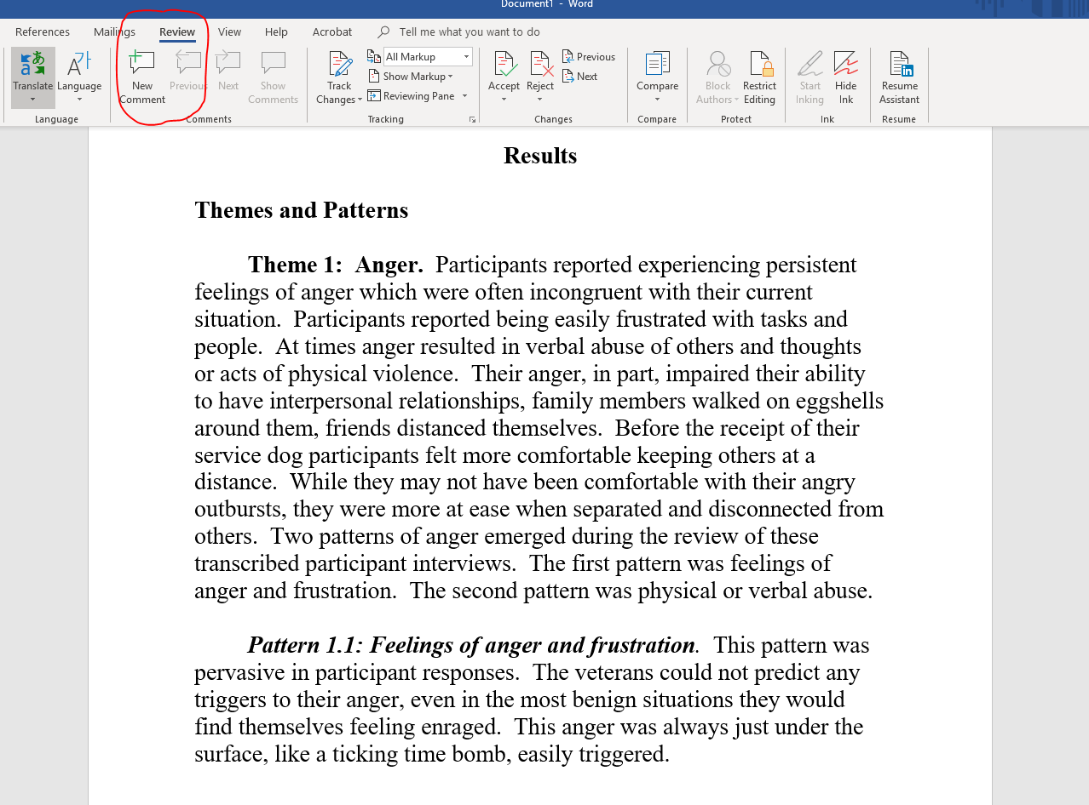
Compose a memo using Microsoft Word’s Comment Tool

Slide 18
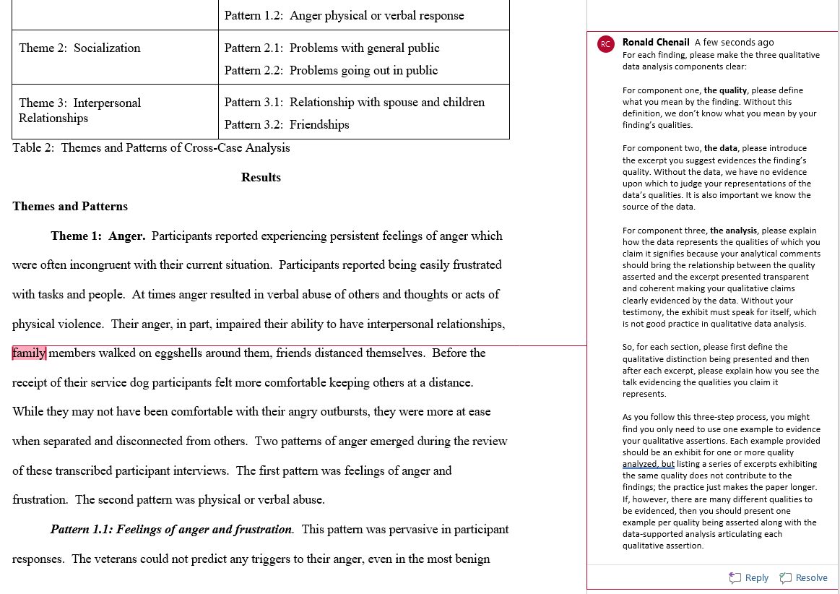

Slide 19
But what about the table?

Slide 20
Excerpt Three
Theme 1: Anger | Verbatim Quotations from the Participants
Pattern 1.1, Angry feelings, easily angered, frustration | “Yeah. And you know sometime…I just all the sudden, you know everything is calm in the house and- and I just, I get that anger. I’m just like, why am I angry? For what? There’s no need but, I don’t know. I don’t know.” “I used- I actually, you know, I’d get so mad that it just, it would, it would just be red. I would see that and I didn’t see anything else.” “I feel more comfortable...I notice when I’m driving, you know the term road rage...I can’t stand (participant’s state of residence) drivers cause half of them can’t drive. High beams in the middle of the night, cause they can’t see, they figure you’re not supposed to see either. Uh, they get on your butt about a foot at sixty miles an hour and when you switch lanes they go back on your butt on the other lane too. Having him (participant’s dog) riding with me, keeps me from killing one of those people on the road.” “Oh, I was angry but I just, I was so angry at myself and the world that it didn’t matter anymore. Um, I didn’t think I was worth living again. Um, I was useless...Uh, I can’t say that anymore. I really can’t.”

Slide 21
To Table or Not To Table?
Necessary?
Sufficient?
Clear?
Judge worthy?

Slide 22
The Trouble with Tables
When you report your findings in the table by listing names of your categories in one column and posting excerpts from your data in the other column, we do not gain a clear understanding what meaning the categories have for you and how the examples evidence the qualitative distinctions you are trying to communicate as a result of your qualitative data analysis. In other words, examples are not the same as evidence.

Slide 23
Table the Table
To construct a more compelling case for your findings, you need to provide testimony that makes the evidential relevance of your exhibits clearer regarding the qualitative distinction(s) you are attempting to argue. Or, more simply stated, please make your findings more evident.
To make the results of your qualitative data analysis clearer, please remove the chart and replace it with a category by category narrative presentation in which you first introduce and define the qualitative essence of the category and second explain how the examples serve as evidence to support your assertions of meaning from the data analysis.

Slide 24
Other Helpful Comments
In the results section, we expect to see exemplary evidence from your data to support your findings. Referring indirectly to your actual data or only paraphrasing your data weakens your arguments and assertions as to what your findings are. To address this concern, please include direct excerpts from your data to support your findings.
When you list multiple excerpts we as readers have to guess in which excerpt is the evidence for the qualities you are suggesting they express. Please revise so you make it clearer where you are suggesting we can find the support in the data for your assertions about the data.
In the Results section of your paper we expect to see the results of your analysis of your data. When you weave in results of other research studies to comment on your own results it can be confusing to the readers. We would prefer you focus on your own findings produced by your data analysis in the Results section and save the discussion of how your findings relate to findings published in other sources for your Discussion section.

Slide 25
Customize and Localize
TQR Ready Review Comments are just the start of a great review.
Customize your comments to bring your guidance closer to the author’s writing.
Localize your comments so they make sense in the overall context of the author’s paper.

Slide 26
Questions, Comments, Suggestions

Slide 27
Contact Information
Ron Chenail, PhD
The Qualitative Report: https://tqr.nova.edu/
Nova Southeastern University
Graduate School of Arts, Humanities and Social Sciences
3301 College Avenue
Fort Lauderdale, Florida USA 33314
Phone: 954.262.3019
Email: ron@nova.edu

