Slide 1
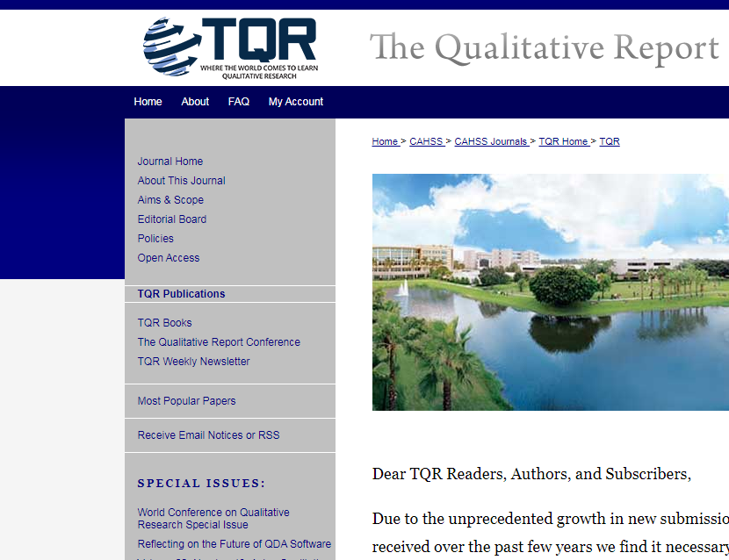
THE QUALITATIVE REPORT
FOR REVIEWERS

Slide 2
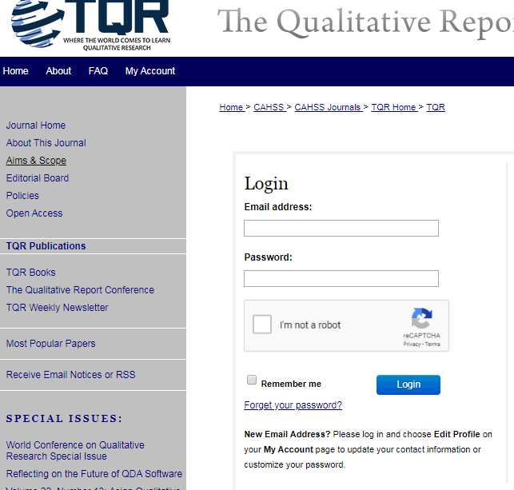
How to Log In

Slide 3
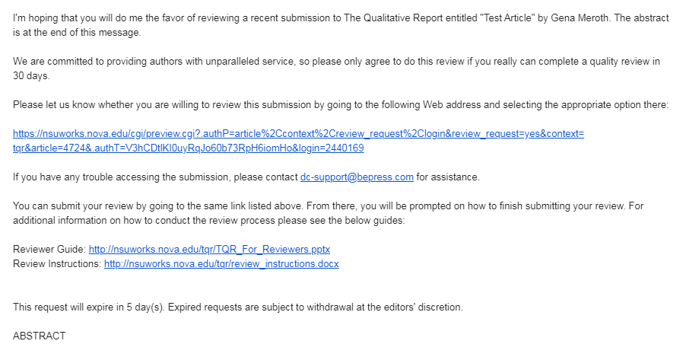
Review Email Request
You will also receive an email request to review the manuscript
Link to manuscript
Reviewer Guide and instructions

Slide 4
My Account Screen
Shows submissions for review:
Click on the title to complete the review.

Slide 5
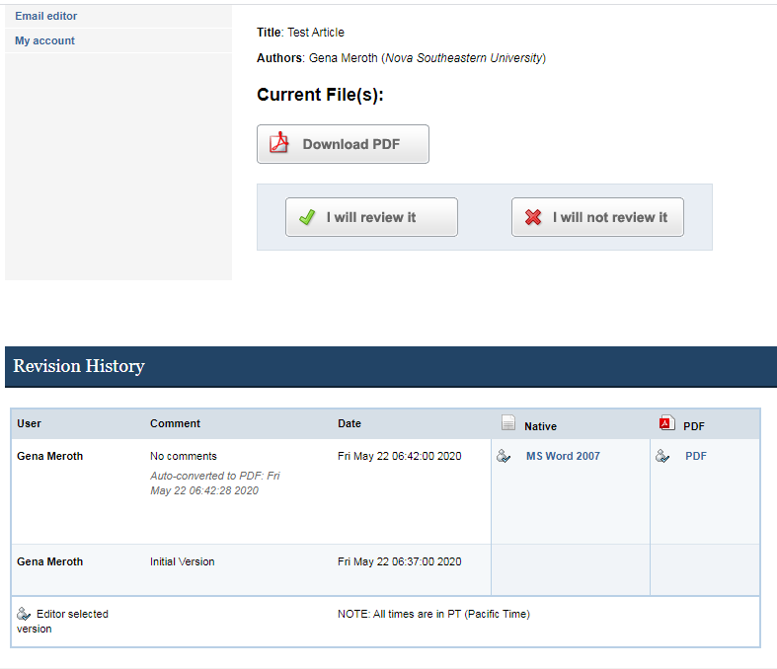
Agree/Disagree to Review
Confirm that you will review the manuscript
Do NOT download the PDF version of the file

Slide 6
Review Instructions
Access Review Instructions Document here:
https://sites.nova.edu/tqr/files/2020/05/TQR_Ready_Review_Comments_Compliments_012520.pdf

Slide 7
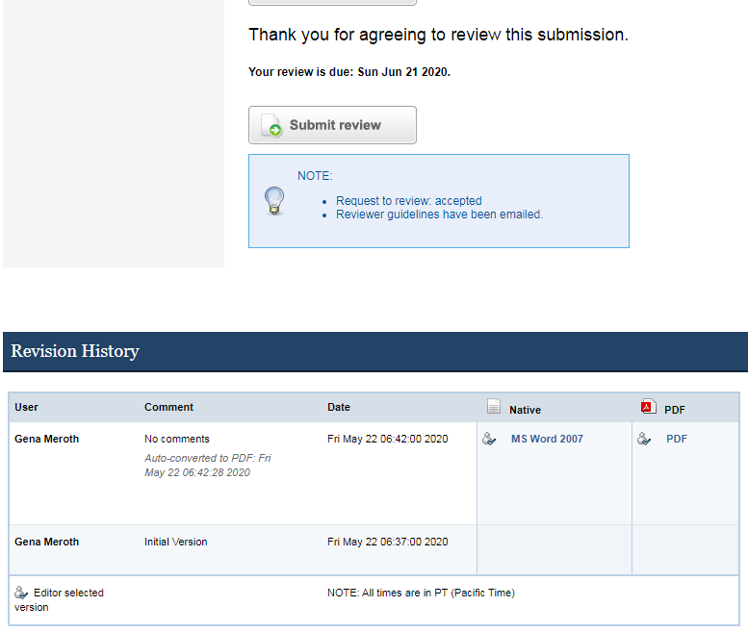
View Article
To review the manuscript use the MS Word version in “Revision History” at the bottom of your Reviewer Account page
Download MICROSOFT WORD version, enable track changes and review

Slide 8
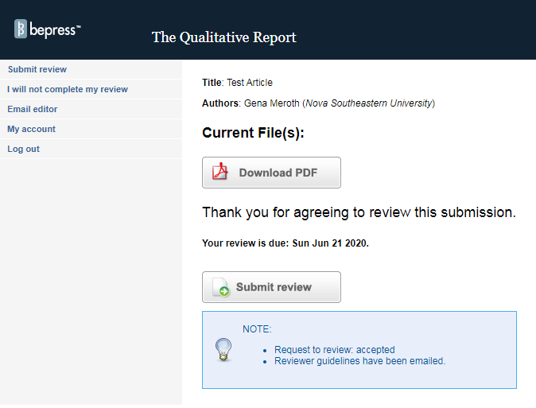
Email Editor if necessary

Slide 9
Submit Review – Step 1

Slide 10
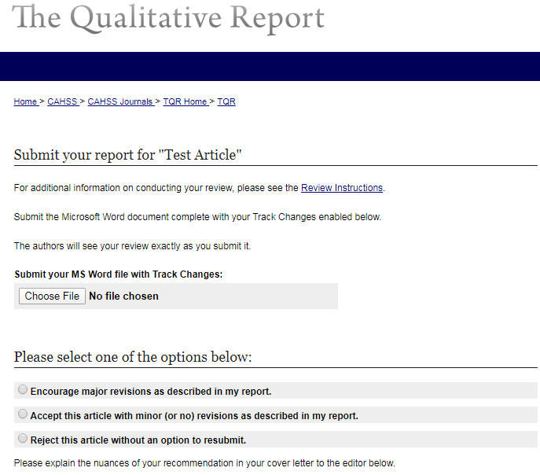
Submit Review: Step 2
Upload the Microsoft Word doc with Track Changes that you created as the primary report
Choose ONE

Slide 11
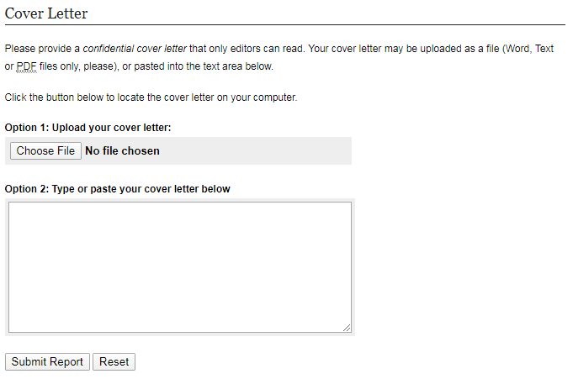
Submit Review : Step 2 continued
Optional letter to editor; upload a letter or type directly in the box
And Submit!

Slide 12
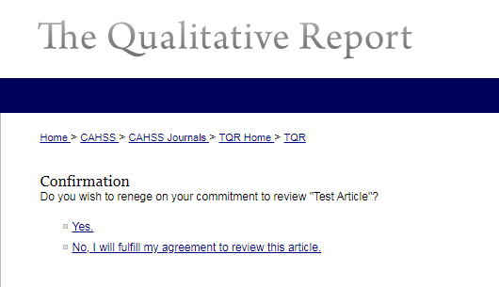
Unable to Review
If you are unable to complete your review commitment click here.
Confirm

Slide 13
Questions?
Ron Chenail
Editor-in-Chief
ron@nova.edu
Gena Meroth
University Archivist/NSUWorks Manager
gmeroth@nova.edu

